Slide 1
Informative Fund Size, Managerial Skill and Investor Rationality by Min Zhu
Speaker: Jian peng
Date:10/05/2017

Slide 2
Three Topics:
1. Is there any significant impact of fund size on fund performance?
2. What is a proper measure of fund management skill?
3. Are investors rational or naïve ?

Slide 3
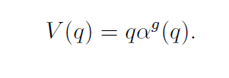
Theoretical Framework
1. Berk and Green's (2004) rational model of active management:
Net alpha directs capital flow and the key point to achieve equilibrium is decreasing returns to scale.
2. Berk and van Binsbergen (2015; hereafter “BvB") : Value Added Measure

Slide 4
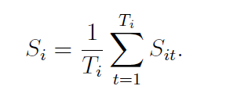
Theoretical Framework (cont’d)
Berk and van Binsbergen: realized value added is a consistent estimate of the maximized value

Slide 5
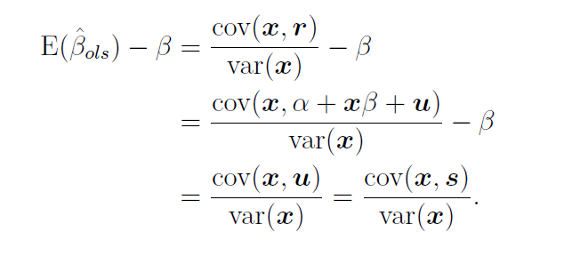
Fund Level Returns to Scale
1. OLS Approach & Endogeneity
Chen, Hong, Huang, and Kubik (2004):

Slide 6
Fund Level Returns to Scale(cont’d)
2. Fixed Effects & contemporaneous correlation
Pastor, Stambaugh, and Taylor (2015):
Fund size increases automatically after an unexpected increase a higher return:

Slide 7
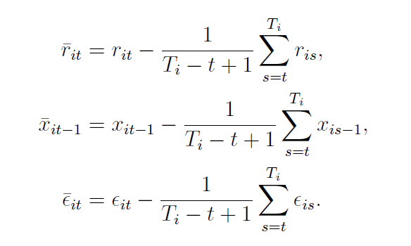
Fund Level Returns to Scale(cont’d)
3.1 RD1 ( Recursive Demeaning Process 1)
Pastor, Stambaugh, and Taylor (2015):

Slide 8
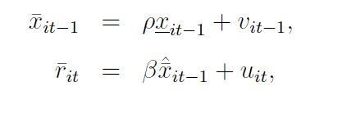
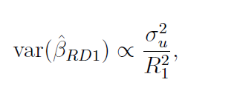
Fund Level Returns to Scale(cont’d)
3.2 Issue with RD1

Slide 9
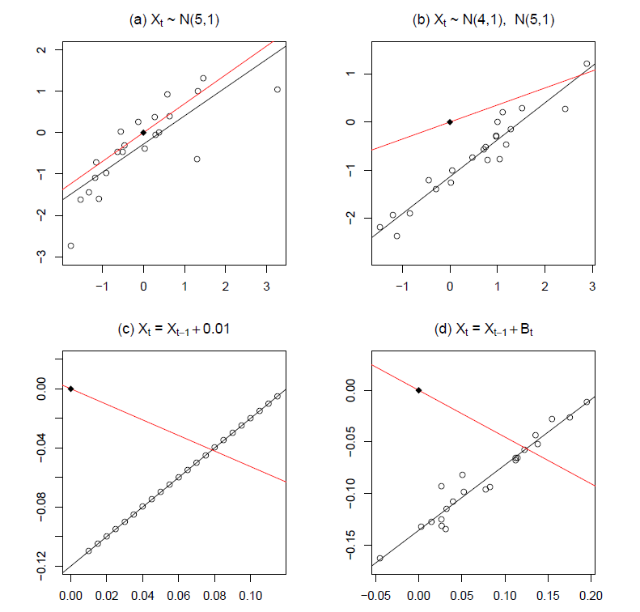
Fund Level Returns to Scale(cont’d)
3.3 Intuition of Zero Intercept

Slide 10
Fund Level Returns to Scale(cont’d)
3.4 RD2 ( An Enhanced Recursive Demeaning Process)

Slide 11
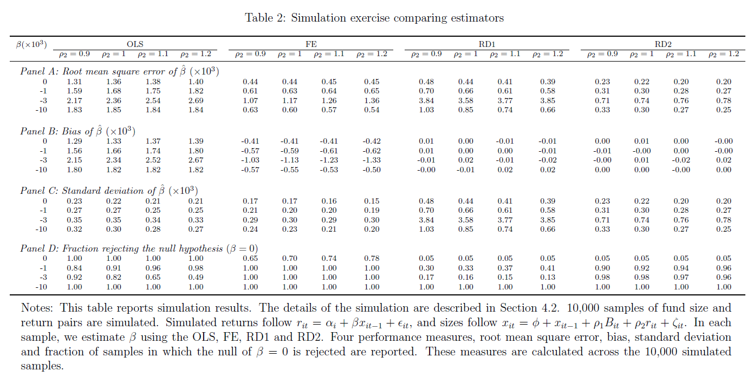
Simulation(pros and cons)

Slide 12
Diseconomies of scale

Slide 13
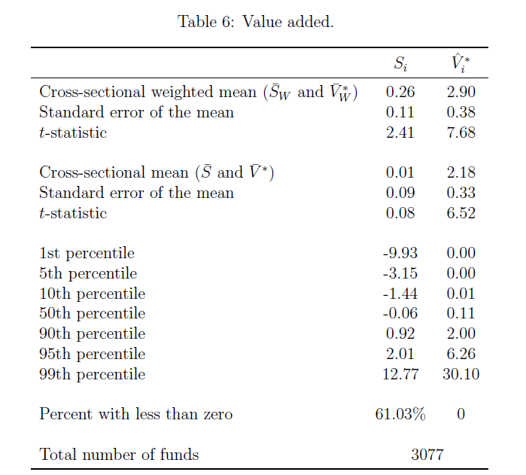
Value Added

Slide 15
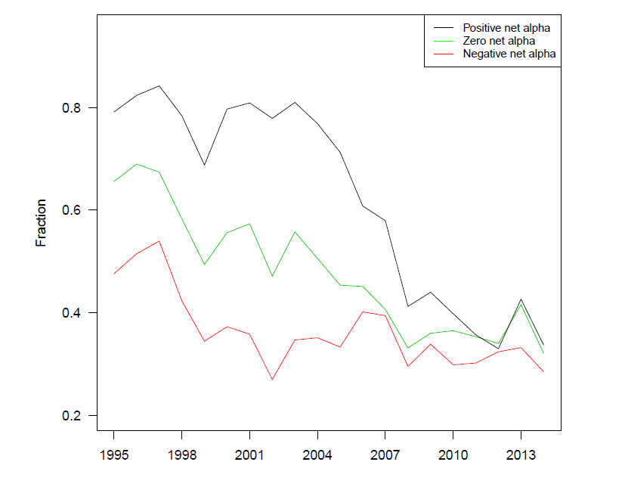
Investor rationality
1. Cross-sectional investor rationality

Slide 16
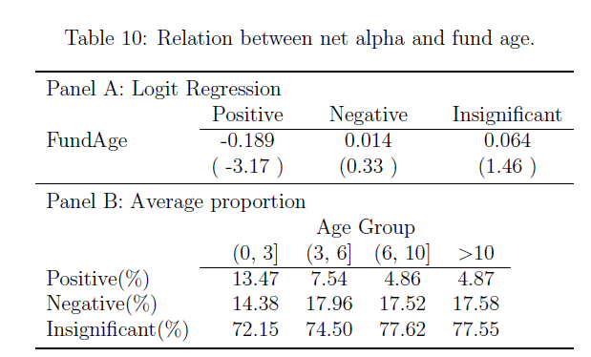
Investor rationality
2. Investor rationality over a fund's lifetime

Slide 17
Conclusion
1. Fund size has a negative impact on fund performance
2. Net Alpha is not a proper measure of skill. Instead, value added is.
3. Investors are not naïve.

